Slide 1
Internet of Things

Slide 2
IoT Protocol Stack
Layer 1 : Physical or Sensor Layer
Layer 2 : Processing and Control Action Layer
Layer 3: Hardware Interface Layer
Layer 4 : RF Layer
Layer 5 : Session/Message Layer
Layer 6 : User Experience Layer
Layer 7 : Application Layer

Slide 3
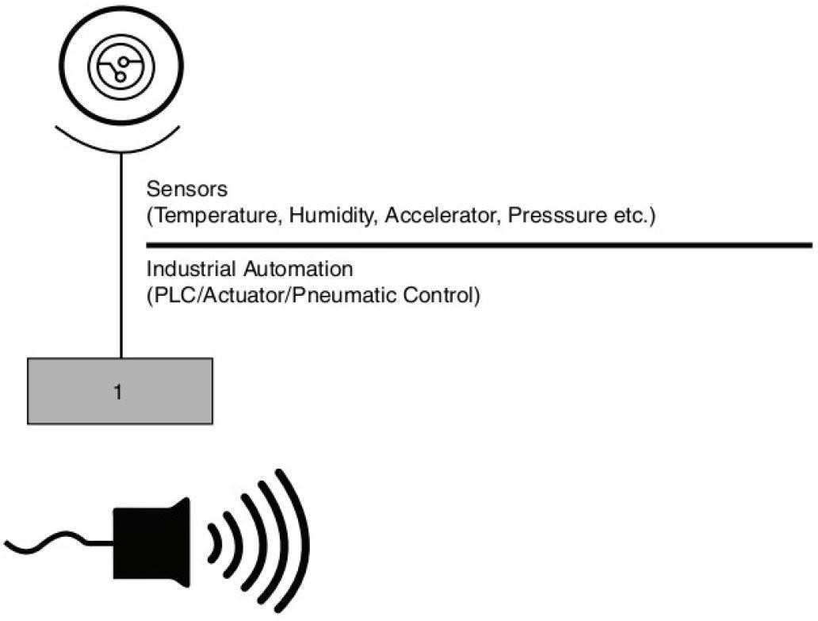
Layer 1 : Physical or Sensor Layer
A sensor is a device that detects the change in the environment and responds to some output on the other system. A sensor converts a physical phenomenon into a measurable analog voltage (or sometimes a digital signal) converted into a human-readable display or transmitted for reading or further processing.
A programmable logic controller (PLC) or programmable controller is an industrial computer that has been adapted for the control of manufacturing processes, such as assembly lines, machines, robotic devices, or any activity that requires high reliability, ease of programming, and process fault diagnosis.
An actuator is a component of a machine that produces force, torque, or displacement, usually in a controlled way, when an electrical, pneumatic or hydraulic input is supplied to it in a system (called an actuating system). An actuator converts such an input signal into the required form of mechanical energy.
A pneumatic control system uses compressed air that is carried through plastic and copper tubes—from a controller to a control device.

Slide 4
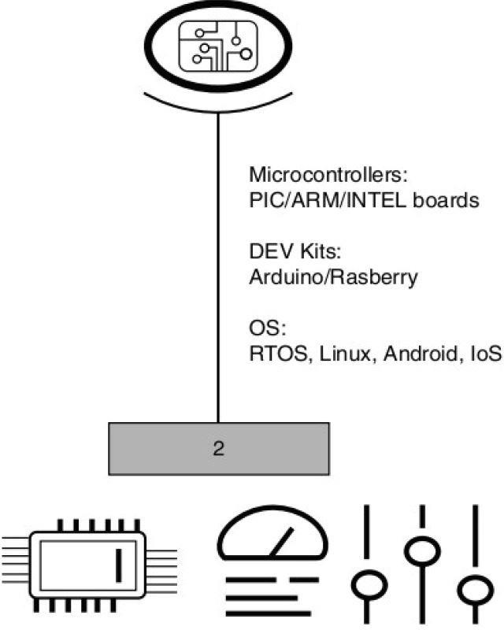
Layer 2 : Processing and Control Action Layer
Peripheral Interface Controller (PIC) / Programmable Interrupt Controller (PIC) is a hardware component that manages and prioritizes interrupt requests (IRQs) from various devices connected to a computer.
Advanced RISC Machine (ARM) Processor is considered to be a family of Central Processing Units that are used in music players, smartphones, wearables, tablets, and other consumer electronic devices. Advanced RISC Machines create the ARM processor architecture, hence the name ARM. This needs very few instruction sets and transistors. It has very small in size. This is the reason that it is a perfect fit for small-size devices.
A real-time operating system (RTOS) is an operating system (OS) for real-time computing applications that processes data and events that have critically defined time constraints.

Slide 5
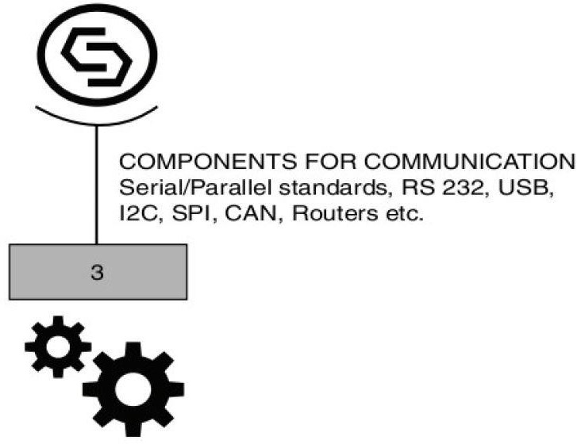
Layer 3: Hardware Interface Layer
Universal Serial Bus (USB) is an industry standard that allows data exchange and delivery of power between many types of electronics.
Inter-Integrated Circuit (I2C) is a two-wire serial communication protocol using a serial data line (SDA) and a serial clock line (SCL). The protocol supports multiple target devices on a communication bus and can also support multiple controllers that send and receive commands and data.
A serial peripheral interface (SPI) is a communication protocol used to transfer data between microcontrollers, sensors, and other peripheral devices. It's like a language they all understand when talking to each other.
The Controller Area Network (CAN bus) is a message-based protocol designed to allow the Electronic Control Units (ECUs) found in today's automobiles, as well as other devices, to communicate with each other in a reliable, priority-driven fashion.

Slide 6
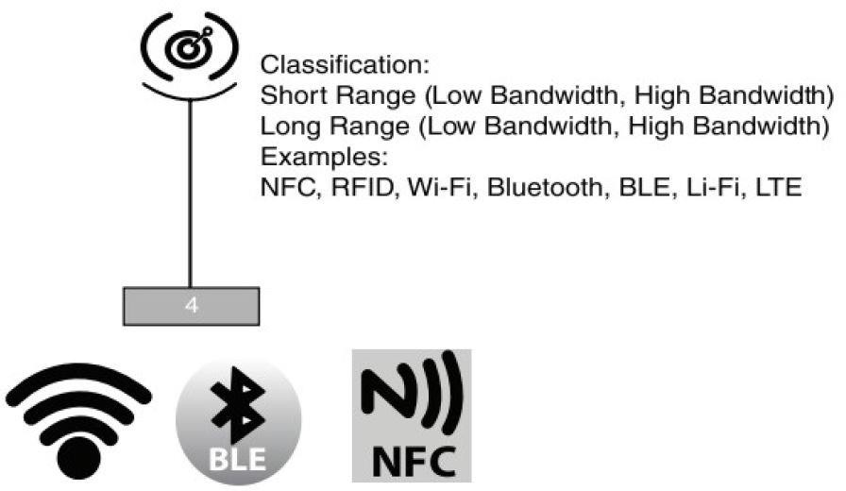
Layer 4 : RF Layer
Near Field Communication (NFC) is a set of short-range wireless technologies, typically requiring a distance of 4 cm or less to initiate a connection. NFC lets you share small payloads of data between an NFC tag and an Android-powered device, or between two Android-powered devices.
Radio Frequency Identification (RFID) refers to a wireless system comprised of two components: tags and readers. The reader is a device that has one or more antennas that emit radio waves and receive signals back from the RFID tag.
Wireless Fidelity (Wi-Fi) is a wireless technology used to connect computers, tablets, smartphones and other devices to the internet. Wi-Fi is the radio signal sent from a wireless router to a nearby device, which translates the signal into data you can see and use.
LiFi (light fidelity) is a bidirectional wireless system that transmits data via LED or infrared light.
Unlike Classic Bluetooth, BLE remains in sleep mode until a connection is initiated. Connection times are typically a few milliseconds, compared with Classic Bluetooth where the connection can take 10x that long. The connections are very short with BLE because the data rates are high, at 1 Mb/s.
long-term evolution (LTE) is a standard for wireless broadband communication for mobile devices and data terminals

Slide 7
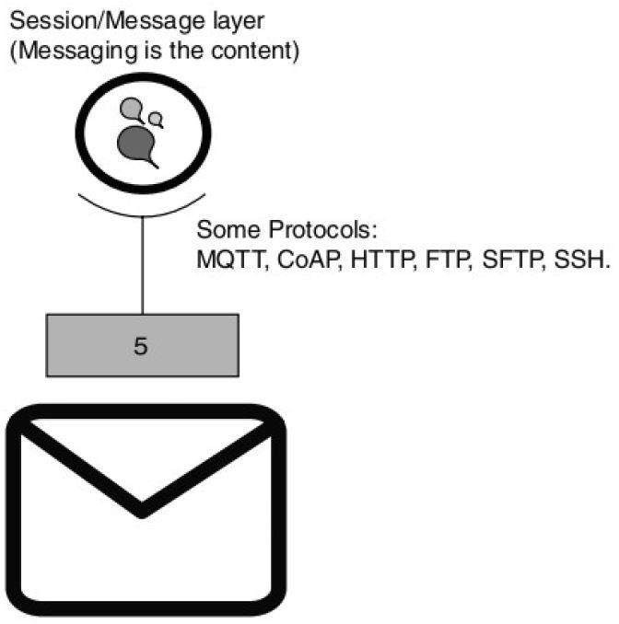
Layer 5 : Session/Message Layer
MQTT stands for Message Queuing Telemetry Transport. It is an extremely simple and lightweight messaging protocol (subscribe and publish) designed for limited devices and networks with high latency, low bandwidth or unreliable networks.
Constrained Application Protocol (CoAP) is a specialized web transfer protocol for use with constrained nodes and constrained networks in the Internet of Things. CoAP is designed to enable simple, constrained devices to join the IoT even through constrained networks with low bandwidth and low availability.
The Hypertext Transfer Protocol (HTTP) is the foundation of the World Wide Web, and is used to load webpages using hypertext links. HTTP is an application layer protocol designed to transfer information between networked devices and runs on top of other layers of the network protocol stack.
Secure Shell (SSH) protocol is a method for securely sending commands to a computer over an unsecured network. SSH uses cryptography to authenticate and encrypt connections between devices.
FTP is the traditional file transfer protocol. It's a basic way of using the Internet to share files. SFTP (or Secure File Transfer Protocol) is an alternative to FTP that also allows you to transfer files, but adds a layer of security to the process.

Slide 8
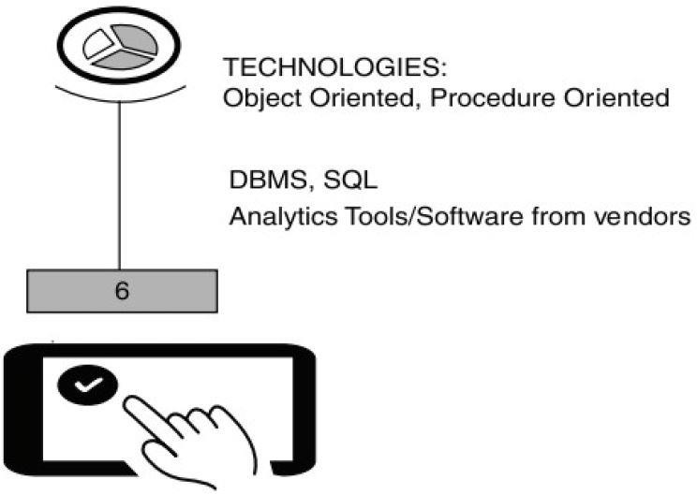
Layer 6 : User Experience Layer
Procedural Programming can be defined as a programming model which is derived from structured programming, based upon the concept of calling procedure. Procedures, also known as routines, subroutines or functions, simply consist of a series of computational steps to be carried out. During a program’s execution, any given procedure might be called at any point. Example: FORTRAN, ALGOL, COBOL, Basic, pascal, C
Object-oriented programming can be defined as a programming model which is based upon the concept of objects. Objects contain data in the form of attributes and code in the form of methods. In object-oriented programming, computer programs are designed using the concept of objects that interact with the real world.

Slide 9
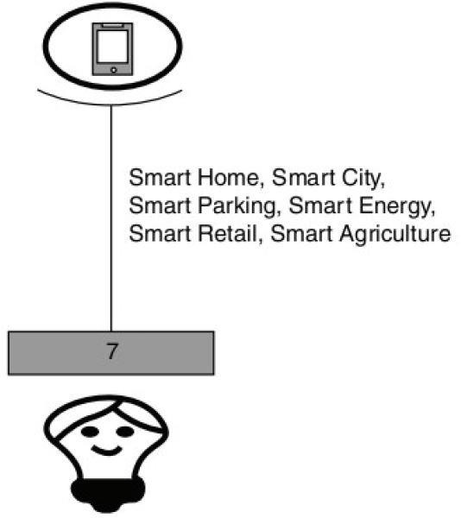
Layer 7 : Application Layer
Application layer protocols are the messaging protocols that these IoT devices use to transport data. Without application layer protocols, Internet of Things devices would have no means by which to share data and information either from device-to-device or from device-to-server.

Slide 10
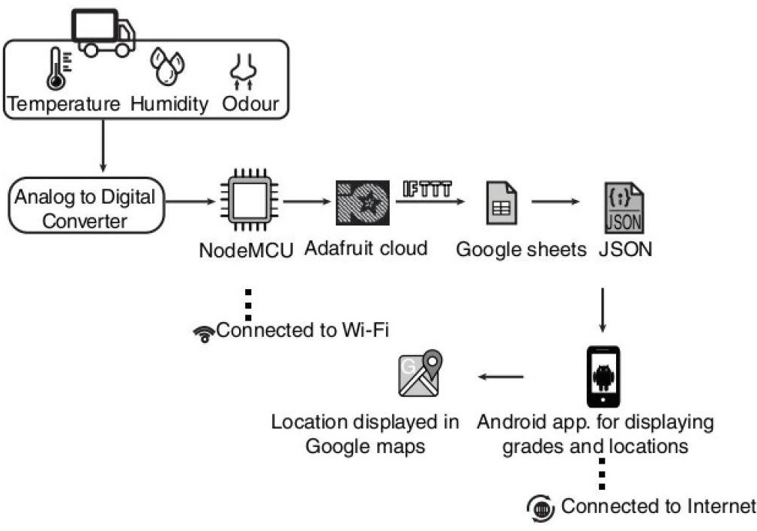
Example:
If This Then That (IFTTT) is defined as a web-based automation platform that enables users to connect different web applications and services to automate tasks and create new functionality.
JavaScript Object Notation (JSON) is a standard text-based format for representing structured data based on JavaScript object syntax.

Slide 11
Physical Design of IoT
A physical design of an IoT system refers to the individual node devices and their protocols that are utilized to create a functional IoT ecosystem.
The things/devices in the IoT system are used for:
Building connections
Data processing
Providing storage
Providing interfaces
Providing graphical interfaces

Slide 12
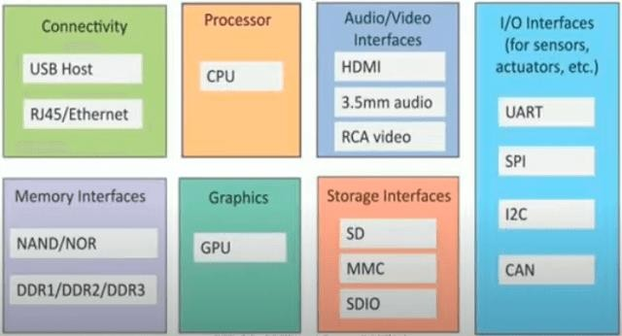
Things/Devices
HDMI - High-Definition Multimedia Interface
RCA - Radio Corporation of America
SD card - secure digital card
MMC – Multi Media Card
SDIO - Secure Digital Input Output
UART - universal asynchronous
receiver / transmitter
SPI - Serial Peripheral Interface
I2C - Inter-Integrated Circuit
CAN - controller area network

Slide 13
IoT Protocols
These protocols are used to establish communication between a node device and a server over the internet. It helps to send commands to an IoT device and receive data from an IoT device over the internet.
We use different types of protocols that are present on both the server and client side and these protocols are managed by network layers like application, transport, network, and link layer.

Slide 14
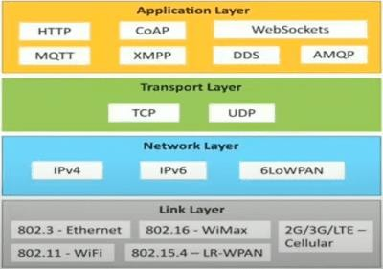
Protocols
MQTT - Message Queuing Telemetry Transport
XMPP - Extensible Messaging and
Presence Protocol
DDS - Data Distribution Service
AMQP - Advanced Message Queuing Protocol

Slide 15
Logical Design of IoT
A logical design for an IoT system is the abstract design of how its components (computers, sensors, and actuators) should be arranged to complete a particular function.
It doesn’t go into the depth of describing how each component will be built with low-level programming specifics.
IoT logical design includes:
IoT functional blocks
IoT communications models
IoT communication APIs

Slide 16
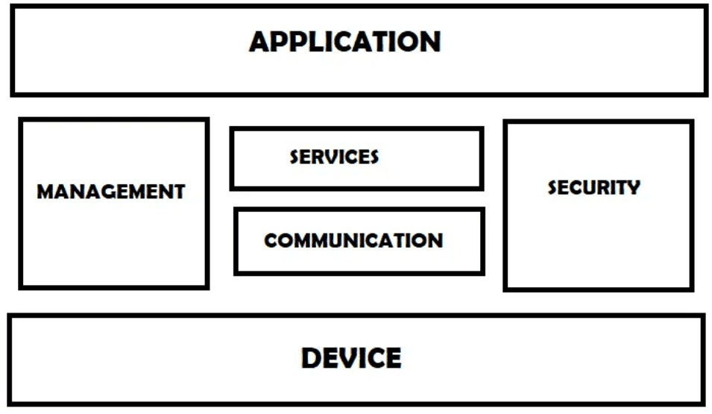
Fundamental Block
IoT systems are composed of a number of building blocks, including sensors/actuators, connectivity, security, services, etc. The functional blocks are responsible for sensing, verification, actuation, management, and communication.

Slide 17
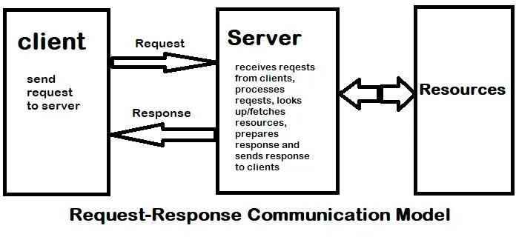
Communication Model – Request Response Model

Slide 18
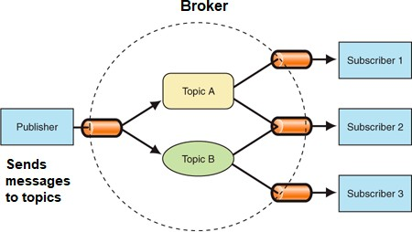
Communication Model – Publish Subscribe Model
Publishers are the source of data. It sends the data to the topic which are managed by the broker. They are not aware of consumers.
Consumers subscribe to the topics which are managed by the broker.
Brokers responsibility is to accept data from publishers and send it to the appropriate consumers. The broker only has the information regarding the consumer to which a particular topic belongs to which the publisher is unaware of.

Slide 19
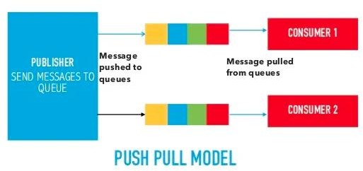
Communication Model – Push Pull Model
The push-pull model constitutes data publishers, data consumers, and data queues.
Publishers and Consumers are not aware of each other.
Publishers publish the message/data and push it into the queue. The consumers, present on the other side, pull the data out of the queue.
Queues help in decoupling the messaging between the producer and consumer. Queues also act as a buffer which helps in situations where there is a mismatch between the rate at which the producers push the data and consumers pull the data.

Slide 20
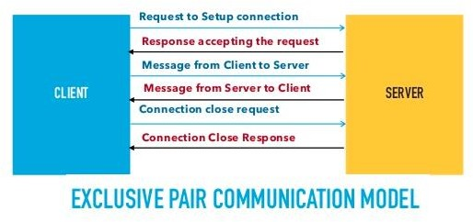
Communication Model – Exclusive Pair Model
Exclusive Pair is the bi-directional model, including full-duplex communication among client and server. The connection is constant and remains open till the client sends a request to close the connection.
The Server has the record of all the connections which has been opened.
This is a state-full connection model and the server is aware of all open connections.
WebSocket based communication API is fully based on this model.

Slide 21
Communication APIs
REST – based Communication API
Representational State Transfer
REpresentational State Transfer (REST) is a set of architectural principles by which you can design web services and web APIs that focus on a system’s resources and how resource states are addressed and transferred.
Follow Request Response Communication Model
Advantages/Disadvantages
Web Socket based Communication
Full Duplex Communication
Follow Exclusive Pair Communication Model
Advantages/Disadvantages

Slide 22
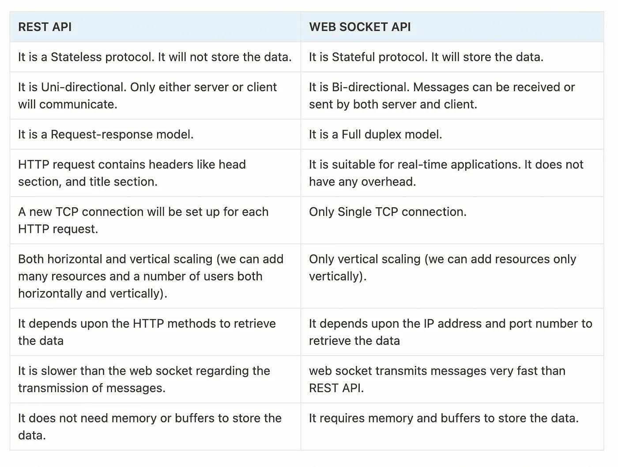
Communication APIs

Slide 23
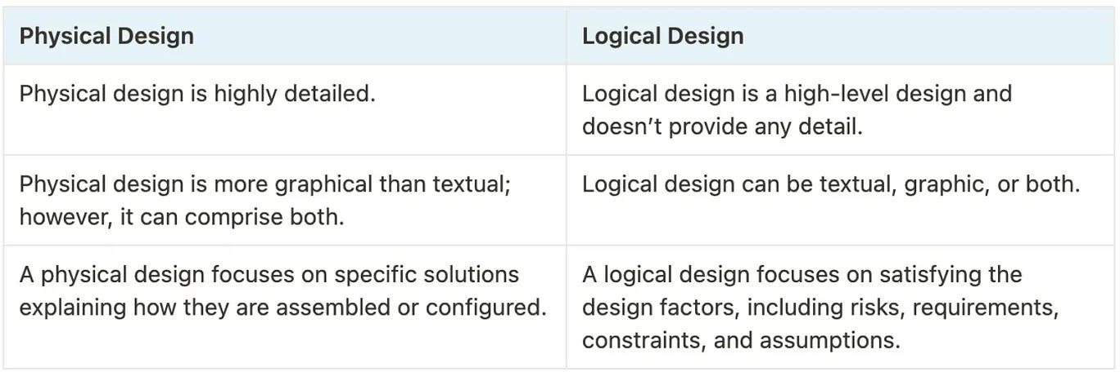
Physical Design vs Logical Design

